Slide 1


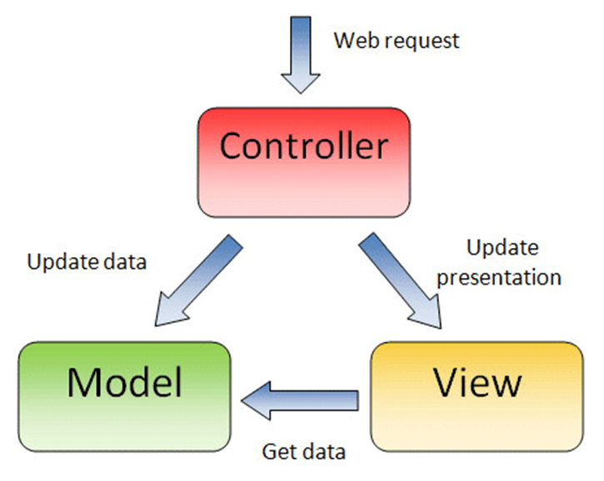


Structuring Web Applications
Model-View-Controller (MVC) Concepts for Web Developers
SoftUni Team
Technical Trainers
Software University
http://softuni.bg

Slide 2

Table of Contents
Typical Web App Structure
Typical PHP Apps Structure
MVC Concepts (Model-View-Controller)
Presentation
Logic
Data
Web Application Frameworks
Building Your Own MVC Framework

Slide 3
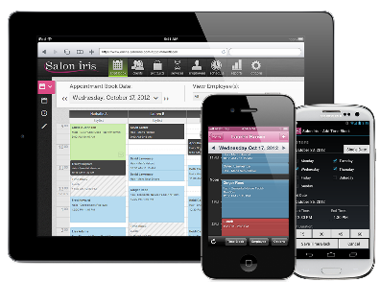


Typical Web App Structure and PHP Apps
Web Browser
Web Browser
Presentation
Views: HTML + PHP
Presentation Logic
PHP Controller Classes
Business Logic
Business Logic Classes
Data Access Logic
PHP Data Access Classes
Database
MySQL

Slide 4
MVC Architecture for Web Apps
MVC == Model-View-Controller
Views (presentation / UI)
Render UI (produce HTML)
Controllers (logic)
Prepare UI (presentation logic)
Update database (business logic)
Models (data)
Data access classes or ORM

Slide 5
Web Application Frameworks
Web apps are typically built with a Web application framework
Build your own Web framework
More flexibility, takes more effort, needs more experience
Use some industrial Web framework
More mature, large community, more functionality, …
PHP: Laravel, Symfony, CodeIgniter, Yii, Phalcon, Zend, …
C#: ASP.NET MVC, ASP.NET Web Forms, Nancy, …
Others: Rails (Ruby), Django (Python), Spring MVC (Java)

Slide 6
Web Frameworks: Presentation
Presentation in Web apps
Views and template engine – render dynamic HTML
PHP files for each view / partial view or based on a view engine
Presentation logic (prepare data for rendering)
PHP controllers: read data from DB, fill it in the view model
Page layout system (headers, footers, sidebars, etc.)
PHP fragments / layout templates
Notifications – show error / info messages
PHP framework logic + notifications partial view

Slide 7
Web Frameworks: Logic
Logic in Web applications
Controllers – process user actions (e.g. button click / form submit)
Presentation logic – prepare data (view models) for the UI
Business logic – do the business operations, e.g. post an article
CRUD operations – list / create / update / delete data
AJAX actions – render partial views or JSON result
Access control (user register, login, logout, admin area)
Session-based user tracking – login / logout / get current user

Slide 8
Web Frameworks: Data
Data in Web applications
Database access logic – execute DB operations
ORM approach – map classes to DB tables
Non-ORM approach – data access classes
Data validation – show errors for invalid form data
Data binding – auto map form data into objects
Data paging, sorting, filtering

Slide 9
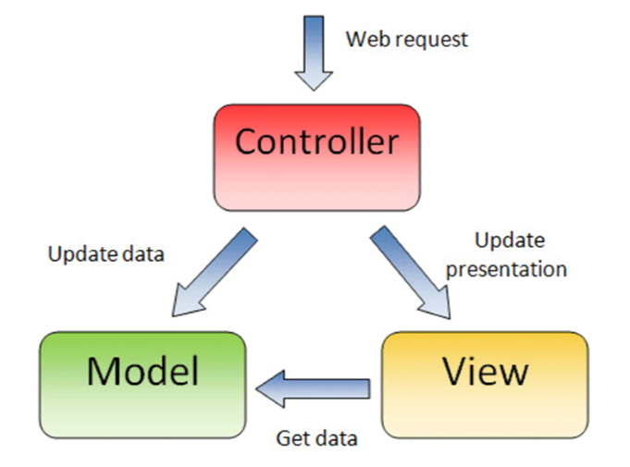

Building a MVC Framework in PHP
Basic Concepts

Slide 10

Front Controller
What is "front controller"?
Architectural design pattern for Web applications
Front controller == centralized entry point for all requests
Controller
View
HTTP Request
Front Controller
Controller
View
Controller
View

Slide 11
Rewriting URLs with .htaccess
Using .htaccess files in Apache
Configures the access to the current folder and its subfolders
Rewriting URLs with mod_rewrite
Route everything except /content/ and favicon.ico to index.php
.htaccess
<IfModule mod_rewrite.c>
RewriteEngine On
RewriteCond %{REQUEST_URI} !^/content/.*$
RewriteCond %{REQUEST_URI} !^/favicon\.ico$
RewriteRule ^ index.php
</IfModule>

Slide 12
Configuration Settings
Web applications hold many configurable application settings
Paths location of views, layouts, controllers, models, etc.
Database connection settings (DB host, username, password, …)
Other constants, e.g. page size, session timeout, …
Configuration settings in PHP – use define(…) or config class
define('DB_HOST', 'localhost');
define('DB_USER', 'root');
define('DB_PASS', 'secr3tP@$$w00rd');
includes/config.php

Slide 13
Implementing the Front Controller
Parse the request URI to extract the controller and action
Controller: "authors". Action: "edit". Parameters: [6]
Load class AuthorsControllers
Invoke function edit(6)
Default controller and default action
Controller: "home". Action: "index". Parameters: []
http://localhost/authors/edit/6
http://localhost

Slide 14
Implementing the Controllers: BaseController
Base controller
Holds the common controller logic
Holds the view model (view bag)
Render view / partial view
Redirect to another action
Current user / authorization
Add notification / error
Other common functionality
BaseController
inherit
Controller
Controller
render
render
View
View
View
View

Slide 15
The Base Controller
abstract class BaseController {
public function __construct($controller, $action) {
$this->onInit();
}
protected function onInit() { } // for overriding
public function renderView($viewName = null) {
// Render layout header + the requested view + the footer
}
protected function redirect(
$controller = null, $action = null, $params = []) {
header("Location: " …); die;
}
}
controllers/BaseController.php

Slide 16
Implementing the Controllers
class AuthorsController
extends BaseController {
protected function onInit() {
$this->title = 'Authors';
}
public function index() {
$authorModel = new AuthorsModel();
$this->authors = $authorModel->getAll();
}
public function create() { … }
public function edit($id) { … }
public function delete($id) { … }
}
controllers/AuthorsController.php
Put a title in the view model
Put a list of authors in the view model

Slide 17


Implementing the Models
Models holds the DB access logic
Can use some ORM (object-relational mapping) framework like Eloquent, Doctrine, Propel, DataMapper ORM, …
Usually data model classes + framework for CRUD + queries
Simple frameworks just implement CRUD operations in DB access classes
BaseModel + classes inheriting from it
BaseModel
inherit
Model
Model

Slide 18
Implementing the Base Model
abstract class BaseModel {
protected static $db;
public function __construct() {
if (self::$db == null) {
self::$db = new mysqli(
DB_HOST, DB_USER, DB_PASS, DB_NAME);
if (self::$db->connect_errno) {
die('Cannot connect to database');
}
}
}
}
models/BaseModel.php

Slide 19
Implementing the Models
class AuthorsModel extends BaseModel {
public function getAll() {
$stmt = self::$db->query("SELECT * FROM authors");
return $stmt->fetch_all(MYSQLI_ASSOC);
}
public function find($id) {
$stmt = self::$db->prepare("SELECT * FROM authors WHERE id = ?");
$stmt->bind_param("i", $id);
$stmt->execute();
return $stmt->get_result()->fetch_assoc();
}
public function create($name) { … }
public function edit($id, $name) { … }
public function delete($id) { … }
}
models/AuthorsModel.php

Slide 20
Implementing the Views
Views render the data from the view model (view bag)
Typically produces HTML fragment
Views can be based on pure PHP or on some view engine
Popular PHP view engines: Blade, Twig, …
Render with Twig
Render with pure PHP
{% for user in users %}
* {{ user.name }}
{% else %}
No user has been found.
{% endfor %}
<?php if (isset($this->users)) : ?>
<ul><?php foreach ($this->users as $user) : ?>
<li><?= htmlspecialchars($user.name)?></li>
<?php endforeach ?></ul>
<?php else : ?>No user has been found.
<?php endif ?>

Slide 21
View Based on Pure PHP
<h1>List of Authors</h1>
<table>
<tr> <th>ID</th> <th>Name</th> <th colspan="2">Action</th> </tr>
<?php foreach ($this->authors as $author) : ?>
<tr>
<td><?= htmlspecialchars($author['id']) ?></td>
<td><?= htmlspecialchars($author['name']) ?></td>
<td><a href="/authors/edit/<?=$author['id'] ?>">[Edit]</td>
<td><a href="/authors/delete/<?=$author['id'] ?>">[Delete]</td>
</tr>
<?php endforeach; ?>
</table>
<a href="/authors/create">[Create New]</a>
views/authors/index.php

Slide 22
Layout System
The page layout system in Web apps
Avoids repeating headers, footers, sidebars and others
Simple implementations
Just include header.php and footer.php
More-complex solutions
Multiple layouts with inheritance
Components (partial views), parameters

Slide 23
Notification System
Info messages
Error messages

Slide 24
Login / Logout / Authorization
Login
Logout
User registration
Authorization

Slide 25
Data Validation
Client side data validation
Server-side data validation

Slide 26
AJAX Calls
AJAX calls
Partial views
Partial page rendering
JSON results + client-side rendering

Slide 27
Data Paging, Sorting and Filtering
Data paging
Grid controls
Data sorting, filtering and paging

Slide 28
Building a MVC Framework in PHP
Live Demo

Slide 29









Structuring Web Applications
https://softuni.bg/courses/web-development-basics/

Slide 30
License
This course (slides, examples, demos, videos, homework, etc.) is licensed under the "Creative Commons Attribution-NonCommercial-ShareAlike 4.0 International" license

Slide 31





Free Trainings @ Software University
Software University Foundation – softuni.org
Software University – High-Quality Education, Profession and Job for Software Developers
softuni.bg
Software University @ Facebook
facebook.com/SoftwareUniversity
Software University @ YouTube
youtube.com/SoftwareUniversity
Software University Forums – forum.softuni.bg

